Slide 1
Gosu Bundles
October 18, 2013
Notes:
Guidewire training materials contain Guidewire proprietary information that is subject to confidentiality and non-disclosure agreements. You agree to use the information in this manual solely for the purpose of training to implement Guidewire software solutions. You also agree not to disclose the information in this manual to third parties or copy this manual without prior written consent from Guidewire. Guidewire training may be given only by Guidewire employees or certified Guidewire partners under the appropriate agreement with Guidewire.

Slide 2
Describe when Gosu code must manually commit data
Create new bundles and commit data in them
Add entities from the database to a bundle
Create new entities in a bundle
Work with properties whose values have changed since the data was read
Copy entities from one bundle to another
Access the "current" bundle

Slide 3
Database transactions and bundles
Creating new bundles
Working with entities in the database
Working with new entities
Additional bundle functionality

Slide 4
Database transactions
start transaction insert... delete... commit
A database transaction is a set of data manipulation statements that are acted upon as a unit
Either all statements succeed or none are acted on
A commit occurs when a transaction completes successfully
This means all changes to the data are now permanent
If any statement in a transaction fails, then all statements are undone, or "rolled back"
Notes:
SQL includes at least three data manipulation language manipulation (DML) statements.
INSERT (which adds one or more rows of data to a given table)
UPDATE (which modifies one or more existing rows of data in a given table)
DELETE (which removes on or more rows of data from a given table)
Database transactions are primarily a combination of DML statement that are typically demarcated:
From the "begin" that starts the transaction
Until either a "commit" (which successfully ends the transaction) or a "rollback" (which undoes the transaction if any statement fails)
An example of a database transaction involves a bank customer with multiple accounts. The customer wishes to transfer $100 from one account to another. Two separate statements are needed to do this. One statement debits the "from" account, and the other credits the "to" account. The statements must be treated as a unit. If one is allowed to succeed while the other fails, then either the customer will lose the transfer money or be double-credited for it.

Slide 5
Notes:
"Transaction" is a term that various Guidewire products define differently. Consider the following examples:
A "policy transaction" is job process that creates or modifies a policy such as a policy change, a cancellation, or a renewal.
In PolicyCenter, a "financial transaction" represents the change in costs for a given quotable aspect of a policy, e.g., the decrease of a deductible in collision coverage increases the cost from $10 to $17.
In BillingCenter, a "financial transaction" refers to the debit of money from one T-account to the credit of money to another T-account.
In ClaimCenter, a "financial transaction" describes the movement of money either set aside for a payment into a reserve line or out of a reserve line to make a payment.
Database transactions in Guidewire product database are not, by default, distributed transactions. A distributed transaction, sometimes referred to as a global transaction, is a set of two or more related transactions that must be managed in a coordinated way. For Java Database Connectivity (JDBC) drivers, distributed transaction functionality is built on top of connection pooling functionality. This distributed transaction functionality is also built upon the open Extended Architecture (XA) standard for distributed transactions. Database transactions in Guidewire products are resource-local (non-global, non-distributed, non-XA) transactions against the Guidewire product database.
This lesson uses the term "transaction" to refer to a non-global, non-distributed, non-XA, resource-local, database transaction against the Guidewire product database.

Slide 6
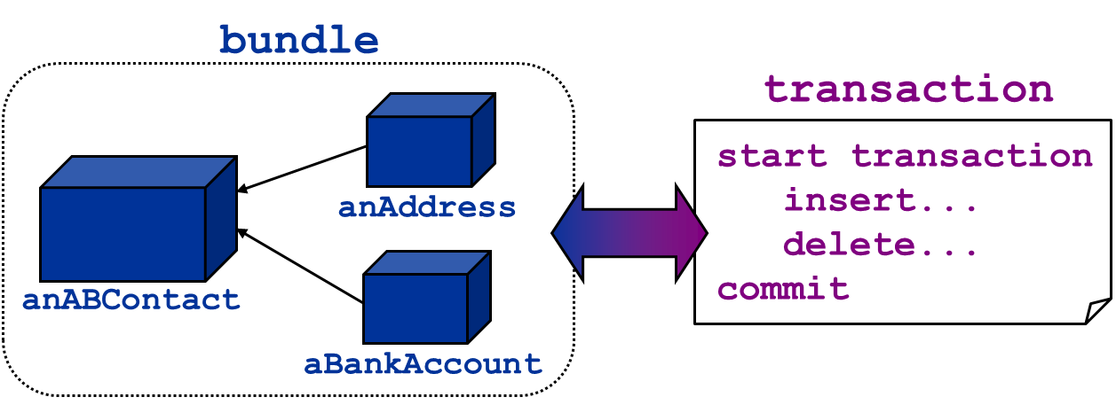
Bundles
A Guidewire bundle is a set of in-memory entities that are saved to the database as a unit
Each bundle corresponds to one database transaction
"Committing a bundle" means saving all entities in the bundle to the database
Notes:
In object-oriented programming, an instance of a class is an object. In database design and modeling, an instance of an entity is a row of data in a database table. In the Guidewire paradigm for integration and configuration, the term "entity" can express a duality of both being a class and a database table. For example, when you create a new instance of a Contact entity using the keyword "new" in Gosu or Java, not only does the Guidewire application create unique object of the type Contact in memory, but it also allows for the possibility for the object in memory to be inserted into a new row in a database table.
Guidewire configurators and integrators may refer to an entity in a bundle as a “database-backed entity”, an entity of type entity.KeyableBean, and/or as entity that implements the KeyableBean delegate. This simply means that the entity is to be inserted into the database when the bundle is committed.
Bundle is a Guidewire class that implements the entity BundleProvider. The Bundle class maintains a graph of objects for the convenience of application code. Bundles can be used to group together a number of entities for transmission to the database. The add method add beans to the bundle. The remove method marks a bean for removal. The commit method invokes a complex procedure that tries to the save the entities in the bundle to the database.

Slide 7
Automatic bundle processing
Possible to automatically commit new and changed data
Explicit bundle manipulation is not required
Business rules
Workflows
Certain plugins
Code executed from the UI in edit mode
Rules
Workflows
Some Plugins
PCF code (edit mode)
Notes:
A plugin implements an interface with one or more functions. Guidewire application code may invoke the interface functions. The situation in which the plugin is called determine whether the plugin needs to explicitly manipulate a bundle.
For example, in ClaimCenter, at the end of the first step of the New Claim wizard , the claim number generator plugin is called. There is an explicit commit before the application moves on to the second step. Thus, the claim number generator plugin code does not need to explicitly manipulate any bundle.

Slide 8
Manual bundle processing
No inherent commit for new and changed data
Explicit bundle manipulation is required for:
Web services
Batch processes
Modifications to entities returned from queries
Certain plugins
Code executed from the UI in read-only mode
Web services
Batch processes
Queries
Certain Plugins
PCF code (read-only mode)
Notes:
There are special bundle issues pertaining to web services, batch processes, and certain plugins. These issues are discussed later in the course.

Slide 9
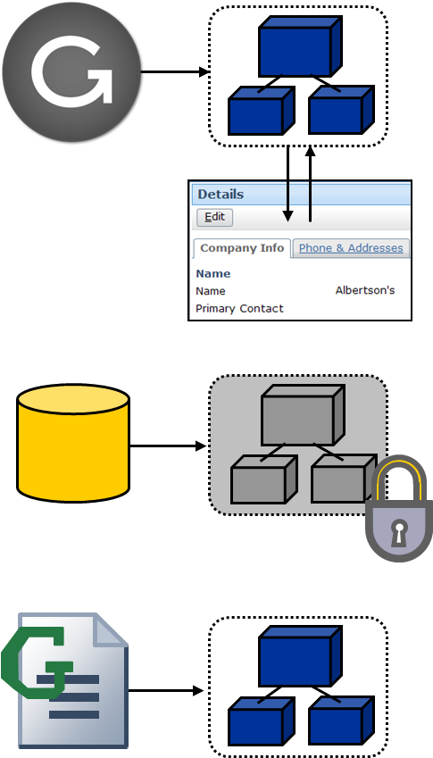
Types of bundles
"Current" bundles
Created when internal code must create, modify, or display data
Contain data used in that context (such as data displayed in the UI)
Read-only bundles
Created when data is retrieved from the database
Contain the retrieved data
New bundles
Created by integration code with contents determined by that code
Notes:
A "current" bundle is a bundle that contains objects available to the current code context. This includes, but is not limited to, the user interface and plugins. These bundles are created automatically by the Guidewire application to create, modify, or edit data. Integration developers can reference entities in the current bundle. They can also commit current bundles, though in some situations this is not advisable. (Working with current bundles is discussed at the end of this lesson.)
A read-only bundle is a bundle that contains entities retrieved from the database. This includes both entities returned as the result of a query, and entities referenced by the foreign key of a related entity when the related entity is in a read-only bundle. The entities in a read-only bundle cannot be modified. However, you can copy entities from a read-only bundle into a writeable bundle.
A new bundle is a bundle created explicitly by integration code. Unlike a read-only bundle, you can modify and commit data in a new bundle. Unlike a current bundle, you can commit a new bundle without having to worry about later interaction occurring in the bundle.

Slide 10
Gosu capabilities with bundles
You can:
Create new bundles
Add entities from the database to a bundle
Create new entities
Modify entities in writeable bundles
Identify whether an entity in a bundle has changed
Commit a bundle
Access the "current" bundle (if one exists)
You cannot:
Evict an entity from a bundle
Modify entities in a read-only bundle
Notes:
Only database-backed entities (entities of type entity.KeyableBean) can be added to a bundle. Each entity can only be in one bundle. It is possible to have multiple entities that correspond to the same row in the database.
You cannot create a custom Gosu class (which is non-database-backed) and add instances of that class to a bundle.
"Evicting" an entity from a bundle means disassociating the entity entirely from the bundle before any commit is attempted. The term "remove" is not used here because "removing an entity" is typically used to mean flagging an entity as retired or deleted so that, when the bundle is committed, the database will logically or physically remove the corresponding row from the database table. You can "remove" an entity from a bundle using Gosu.
The entity’s bundle is available in the Bundle property of the given entity.

Slide 11
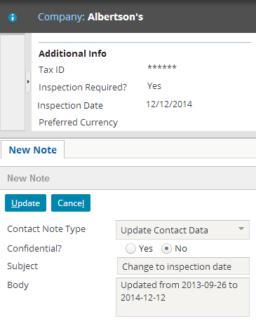
Use case: Company inspection dates
Inspection date field
In TrainingApp for ABCompany
Retrieve the company from the database
Set the inspection date to a specified date
Create a note that details the change in date values from previous to new
Notes:
In TrainingApp, ABCompanies can have an inspection date. There are several methods that are required to record when inspection dates are changed.
First, you need a method to retrieve the company from the database. Second, you need a method to set the inspection date to a specified date. Lastly, you need to create a note that captures the date change from the previous value to the new value.

Slide 12
Database transactions and bundles
Creating new bundles
Working with entities in the database
Working with new entities
Additional bundle functionality

Slide 13

Creating a new bundle
Creating a new bundle (no user specified): gw.transaction.Transaction. runWithNewBundle(\ newBundle -> { CodeBlock } )
Creating a new bundle (as specified user): gw.transaction.Transaction. runWithNewBundle(\ newBundle -> { CodeBlock } , user )
The runWithNewBundle() method inherently commits the bundle at the end of the method
Do NOT commit the bundle, e.g., bundle.Commit()
Notes:
New bundles are always writeable.
In some situations, there is an inherent user. For example:
If bundle code is executed from the UI, it is executed as the user who triggered the UI event that runs the code.
If bundle code is executed from a web service, it is executed as the user specified by the web service call.
In other situations, there is no inherent user, such as:
A web service that requires no authentication and where there may be no user specified in the web service call.
A batch process.
In these situations, you must use the second signature above and specify a user to associate the bundle to.
In either case, commits in the bundle are limited to what the associated user has permission to do. If the user lacks the needed permissions, then an InsufficientPermissionException is thrown. For example, if the bundle attempts to commit changes to admin data, but the associated user lacks permission to change admin data, then the commit will fail.
The runWithNewBundle() method inherently commits the bundle at the end of the method. Do not need to explicitly commit data within the runWithNewBundle() block.
If an entity exists in a modified form in more than one bundle and both bundles commit, the second one fails with a concurrent data modification exception.

Slide 14
Example: Creating a new bundle
9 public static function setInspectionDateByPublicID( publicID: String, inspectionDate: DateTime) : String {
…15 Transaction.runWithNewBundle(\ newBundle -> {
// Find the specific company using a query
…18 var targetCompany = queryObj.select().AtMostOneRow
23 // targetCompany must be copied to new bundle
24 targetCompany = newBundle.add(targetCompany)
25 // Set the Inspection fields as appropriate
…27 targetCompany.InspectionDate = inspectionDate
28 // Create note to record the change 29 var newNote = new ContactNote()
…35 // Add note to bundle entity
36 targetCompany.addToContactNotes(newNote)
…39 // runWithNewBundle() executes an implicit commit // User context is required when none is supplied 41 }, "su")
…43 }
Notes:
You can review the entire method in the BundleExampes.gs class. The example includes a reference to the fully qualified names of gw.api.database.Query, gw.api.database.Relop, and gw.transaction.Transaction.
The slide shows snippets of the setInspectionDateByPublicID() method. The rest of the method is detailed during the remainder of this lesson.
Line 15: Creates a new bundle called newBundle.
Line 18: Selects the query object. This entity instance is in a read-only bundle.
Line 24: Adds the read-only bundle entity to the new bundle! This is what allows the object to be edited with scope of the transaction.
Line 29: Creates a new ContactNote. This note is editable, however, it exists in memory and is not yet a note that exists in the database.
Line 36: Adds the ContactNote to the ABCompany instance. ContactNote is a foreign key array field for ABCompany. Guidewire automatically creates the addToContactNotes() method for foreign key array fields.
Line 41: Ends the transaction block and in doing so, commits the bundle. The specified user supplies the user context.

Slide 15
Database transactions and bundles
Creating new bundles
Working with entities in the database
Working with new entities
Additional bundle functionality

Slide 16
Adding existing entities to a bundle
newBundle
database
newBundle.add()
query
company1
aPerson.Employer
aPerson
company2
You can add an entity from the database to a bundle by:
Querying for it and copying it into the bundle
Reference it from an existing entity's foreign key
Notes:
The example above depicts a bundle that initially contains only the aPerson entity. Three entities are then added to the bundle:
company1 is added by querying for an ABCompany entity from the database, which places it into a read-only bundle, and then copying it via the add() method to the writeable bundle.
company2 is added by referencing the company from the existing aPerson entity's Employer foreign key.

Slide 17
Querying
bundle
bundle. add()
query
database
company1
company1
Use a Gosu query builder to query for entities
Queried entities are returned in a read-only bundle
entity.Bundle.ReadOnly
To modify, copy into a writeable bundle
Syntax: origEntity = bundleToCopyTo.add(origEntity)
Reassign the value of the existing variable
It is possible to assign to new variable object
Notes:
It is possible to retrieve an entity using a find expression. However, find expressions can have unexpected performance costs. Even though the functionality is not yet deprecated, Guidewire recommends using query builders for writing queries against the database.
The results of an entity query are read-only. In order to modify the entity, the entity must be added to a bundle.
It is possible to assign the return value to a new variable whose name differs from the originally variable. For example:
var myCompany = currentBundle.add(company)
The general practice, however, is to reassign the value of the existing variable. In other words, the standard convention is to assign the return value of the bundle.add() method to the existing variable that originally referenced the read-only entity. For example:
company = currentBundle.add(company)

Slide 18
Example: Querying
46 public static function setInspectionDateByName(name: String, inspectionDate: DateTime) : String {
…52 Transaction.runWithNewBundle(\ newBundle -> {
52 var queryObj = gw.api.database.Query.make(ABCompany)
53 queryObj.compare("Name", Relop.Equals, name) 55 var targetCompany = queryObj.select().AtMostOneRow
59 // targetCompany must be copied to new bundle
…61 targetCompany = newBundle.add(targetCompany)
76 }, "su")
…78 }
References include:
gw.api.database.Query
gw.api.database.Relop
gw.transaction.Transaction
Line 52: query for entity
Line 61: added to bundle
Notes:
You can review the entire method in the BundleExamples.gs class. The example includes a reference to the fully qualified names of gw.api.database.Query, gw.api.database.Relop, and gw.transaction.Transaction.
Line 45: Creates a new bundle called newBundle.
Lines 52-54: Selects the query object. This entity instance is in a read-only bundle.
Line 60: Adds the read-only bundle entity to the new bundle! This is what allows the object to be edited with scope of the transaction.
Line 75: Ends the transaction block and in doing so, commits the bundle. The specified user supplies the user context.

Slide 19
Referencing by foreign key
bundle
aPerson.Employer
database
aPerson
company2
Add an entity to a bundle by referencing it through the foreign key of some existing entity
Syntax: existingEntity.ForeignKeyToNewEntity
If the primary entity is already in a writeable bundle, then the foreign key entity is also writeable
If the existing entity is in a read-only bundle, then the foreign key entity is read-only and must be copied to a writeable bundle
Notes:
It is possible to determine if an entity is in a read-only bundle with entity.Bundle.ReadOnly. The ReadOnly boolean property shows whether modifications can be made to beans in the bundle.

Slide 20
Example: ForeignKey array
80 public static function setInspectionDateByEmployee( person: ABPerson, inspectionDate: DateTime): String {
…86 Transaction.runWithNewBundle(\newBundle -> {
87 var targetCompany = person.Employer
92 // targetCompany must be copied from read-only bundle to new bundle
93 targetCompany = newBundle.add(targetCompany)
…109 }, "su")
…111 }
Example uses:
gw.api.database.Query
gw.api.database.Relop
gw.transaction.Transaction
Line 86: foreign key reference
Line 93: added to bundle
Notes:
In the slide example, the setInspectionDateByEmployee() function specifies that person is an input parameter. As an input parameter, person can be either read-only or writeable. ssuming that person is read-only, in order to make targetCompany writeable, targetCompany must be added to the new bundle. You can determine if an entity is part of a read-only bundle. Use the entity.Bundle.ReadOnly property. You can review the entire method in the BundleExamples.gs class. The example includes a reference to the fully qualified names of gw.api.database.Query, gw.api.database.Relop, and gw.transaction.Transaction.
Line 86: Creates a new bundle called newBundle.
Line 87: Gets the ABCompany from the person input parameter foreign key reference. This entity instance is in a read-only bundle.
Line 93: It is a good habit to add the foreign key entity to the bundle. There is no harm in re-copying an entity from the new bundle into the new bundle. In practice, it may be easier to copy all entities retrieved from foreign keys into the new bundle, as this removes the need to address whether the referencing entity is in a writeable bundle. Person may be already in a writeable bundle. You can Use entity.Bundle.ReadOnly to determine if the bundle is writeable or read-only. If editing person, you should add person to the new bundle either way.
Line 109: Ends the transaction block and in doing so, commits the bundle. The specified user supplies the user context.

Slide 21
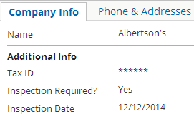

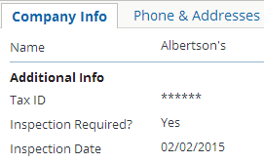
Examples in action
1 uses trainingapp.demo.gosu.BundleExamples 2
3 BundleExamples.setInspectionDateByPublicID("ab:61", 4 "2014-12-12" as java.util.Date)
5 BundleExamples.setInspectionDateByName("Albertson's", 6 "2015-01-01" as java.util.Date)
7 var employee = ta.QueryUtil.findPerson("ab:5")
8 BundleExamples.setInspectionDateByEmployee(employee, 9 "2015-02-02" as java.util.Date)
Notes:
The third example above works only if William Andy (whose public ID is ab:5) is an employee of Albertson's. The three methods shown above all have a common block of code that creates a contact note to detail the inspection date assignment.

Slide 22
Database transactions and bundles
Creating new bundles
Working with entities in the database
Working with new entities
Additional bundle functionality

Slide 23
Creating a new entity
newBundle
database
company1
newNote
Create new entities and associate them with existing entities
Bundle code can do more than merely retrieve entities from the database and modify them

Slide 24
Example: Creating a new entity
24 // targetCompany must be copied to new bundle
25 targetCompany = newBundle.add(targetCompany)
29 // Create note to record the change 30 var newNote = new ContactNote()
31 newNote.Subject = "Change to inspection date" 32 newNote.ContactNoteType = "data_update"
…34 newNote.Body = "Inspection date updated from " + originalInspectionDate +
35 " to " + targetCompany.InspectionDate
36 // Add note to bundle entity
37 targetCompany.addToContactNotes(newNote)
var newEntity = new EntityType()
Not associated to any existing entity, but is inherently part of the new bundle
entityInBundle.addToXXX(newEntity)
Set any required foreign keys manually to commit
Notes:
You can find this snippet in BundleExamples.gs.
When using an addToXXX() method (such as "addToContactNotes() as shown above), you do not need to set the foreign key on the child element to the parent element. Each addToXXX() method does this implicitly.
If you have a situation involving multiple bundles, then you can create a new entity in the bundle of a given entity using one the following syntaxes:
var entity = new EntityType(givenEntity)
var entity = new EntityType(givenEntity.bundle)

Slide 25
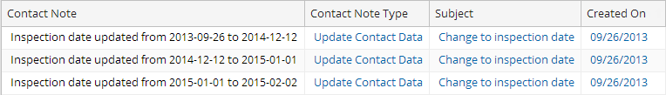
Examples in action
1 uses trainingapp.demo.gosu.BundleExamples 2
3 BundleExamples.setInspectionDateByPublicID("ab:61", 4 "2014-12-12" as java.util.Date)
5 BundleExamples.setInspectionDateByName("Albertson's", 6 "2015-01-01" as java.util.Date)
7 var employee = ta.QueryUtil.findPerson("ab:5")
8 BundleExamples.setInspectionDateByEmployee(employee, 9 "2015-02-02" as java.util.Date)
Notes:
The third example above works only if William Andy (whose public ID is ab:5) is an employee of Albertson's.

Slide 26
Database transactions and bundles
Creating new bundles
Working with entities in the database
Working with new entities
Additional bundle functionality

Slide 27
Original values
Prior to the commit, Gosu retains a copy of each entity read from the database
Several properties and methods let you work with the original data in the entity
entityName.Changed
Returns true if any property on entity has changed
entityName.isFieldChanged("FieldName")
Returns true if property has changed since it was read from database
entityName.getOriginalValue("FieldName")
Returns value read from database
Notes:
The getOriginalValue method takes in a string input parameter which names the property whose value must be retrieved. It returns the value of that property. Keep in mind that the data type of the method depends on the named property. It could return an integer, string, Boolean, date, typekey (for typekey properties), or entity references (for foreign key properties).
For typekeys, getOriginalValue returns the original typekey. You may want to access the typekey's name. (For example, you might want to write a history event that says "Status changed from Pending to Closed". "Pending" is the typekey's name.) To do this, use the following syntax:
(entity.getOriginalValue(entity#typekeyProperty) as typelistName).
For foreign keys, getOriginalValue returns the ID of the original object. You may want to access data from that object, such as an object's display name. For example, you might want to write a history event that says "Assigned user changed from Alice Applegate to Ben Baker", where "Alice Applegate" is the display name of the original assigned user object. To do this, use the following syntax:
// This retrieves the object that the foreign key previously referenced.
var previousForeignKey = changedObject.getOriginalValue(“foreignKeyField”)

Slide 28
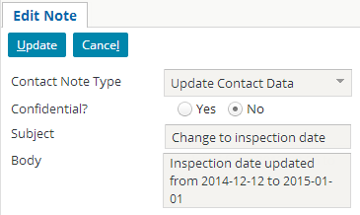
Example: Using original values
28 // Create note to record the change 29 var newNote = new ContactNote()
30 newNote.Subject = "Change to inspection date" 31 newNote.ContactNoteType = "data_update"
32 var originalInspectionDate = targetCompany.getOriginalValue("InspectionDate")
33 newNote.Body = "Inspection date updated from " + originalInspectionDate +
34 " to " + targetCompany.InspectionDate
…35 // Add note to bundle entity
36 targetCompany.addToContactNotes(newNote)
Notes:
When using an addToXXX() method (such as "addToContactNotes() as shown above), you do not need to set the foreign key on the child element to the parent element. Each addToXXX() method does this implicitly.
If you have a situation involving multiple bundles, then you can create a new entity in the bundle of a given entity using one the following syntaxes:
var entity = new EntityType(givenEntity)
var entity = new EntityType(givenEntity.bundle)

Slide 29
Working with multiple bundles
Multiple bundles are required when you need to:
Commit some entities in a bundle, but not all of them
Execute multiple commits that should each succeed or fail on their own
Execute a chain of dependent commit
if success...
Notes:
Some things should be done in a single bundle. For example, if you are debiting Smith’s account and crediting it to Jones’ account with two separate bundles, you risk getting the database into an inconsistent state if one bundle commit succeeds and the other fails. If it is one transaction, consistency will be maintained. That said, there are several situations and common scenarios where you need to create multiple bundles.
In some cases, you may have a bundle and you want to commit some but not all of the data. For example, a bundle might contain a policy submission and 8 quotes that were created while the policy holder was exploring options. You want to commit the policy submission itself and the one quote the policy holder accepted, but you don't want to commit the 7 quotes the policy holder has decided not to accept. For a given bundle, you cannot remove data or commit only some of the data. But, you can create a second bundle, copy the data to be committed to that bundle, and then commit the second bundle.
In some cases, you may have a bundle and you want to commit all of the data in it. But you don't want to commit all of the data at once either because (1) the commit of each data set should occur whether the commit of the other data set succeeds or fails, or (2) the commit of the second data set should occur only if the first data set is committed successfully. If you attempt to commit the original bundle, then either all commits will occur or all commits will fail. The only way to subdivide the bundle into separate groups of data is to create multiple additional bundles, copy the appropriate data into the appropriate bundle, and then commit each bundle separately.

Slide 30
What entities can you copy to a bundle?
first bundle
second bundle
unmodifiedEntity
copyOf UnmodifiedEntity
modifiedEntity
newEntityIn1stBundle
newEntityIn2ndBundle
Notes:
You can copy an entity from one bundle to another only if the entity has not yet been modified.
You cannot "move" an entity from one bundle to another. "Move" implies the entity is deleted from the original bundle, and you cannot delete an entity from a bundle.
You cannot copy an entity from one bundle to another if the entity has been marked as changed. This means:
Modified entities cannot be copied to a new bundle.
New entities (which are inherently marked as changed upon creation) cannot be copied to a new bundle.
In other words, if you need to change and commit some but not all of the entities in a bundle, copy the relevant entities to a new bundle before you make any changes to them. If you need to create and commit new entities, always create them in the bundle from which they will be committed.

Slide 31
Create a new bundle and copying entities
Copying entities into a new bundle:
copyOfEntity = bundleToCopyTo.add(origEntity)
This is the same method used to copy entities from read-only bundles into writeable bundles
(original bundle)
bundleToCopyTo
origEntity
copyOfEntity
Notes:
The add() method is always used to copy an entity into a new bundle, which includes:
Copying entities from read-only bundles to writeable bundles
Copying entities from one new bundle into another new bundle
Because you must explicitly copy entity instances into the bundle, you have control over which instances get copied (and therefore which instances get committed).

Slide 32
Working with the "current" bundle
Sometimes, code has access to a "current" bundle, which contains data "known" to the current context
For code called from… | … the current bundle contains:
the User Interface | data retrieved and/or displayed in the User Interface
a plugin | data passed to the plugin
Notes:
Guidewire web services and batch processes do not have current bundles. If either of these mechanisms needs to create or modify data, then a new bundle must be created.
New bundles are discussed further in the "Publishing Guidewire Web Services" and "Batch Processes" lessons.

Slide 33
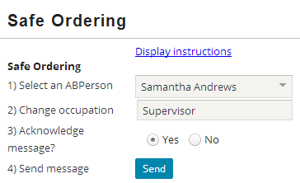
Current bundle syntax
gw.transaction.Transaction.getCurrent()
Gets current bundle
bundle.Commit()
Commits every entity in the bundle
Developers should be extremely cautious when committing the current bundle
function sendABPersonMessage() : void { selectedABPerson.Occupation = newABPersonOccupation var currentBundle = gw.transaction.Transaction.getCurrent()
currentBundle.commit() }
Notes:
Every entity has a "bundle" property that you can use to access the bundle containing the entity.
Syntax: entity.bundle.
Developers should be extremely cautious when committing a current bundle. Committing the data in the code may conflict with further activity associated to the current bundle's context. For example, imagine that there is a UI button that executes code which accesses the current bundle, modifies entities in it, and then commits the bundle. If the user clicks the button and then makes additional changes to data in the UI, the additional changes cannot be saved. When the attempt is made to commit the additional changes, Guidewire will throw an exception. Therefore, one should commit the current bundle only when one can be certain that no further changes will be made to the data in that bundle.

Slide 34
Describe when Gosu code must manually commit data
Create new bundles and commit data in them
Add entities from the database to a bundle
Create new entities in a bundle
Work with properties whose values have changed since the data was read
Copy entities from one bundle to another
Access the "current" bundle

Slide 35
Name two circumstances where:
Changes to data are automatically committed
Changed to data must be committed in code manually
What is a bundle?
What kind of entities are initially put into read-only bundles? Under what circumstance would you need to copy one of those entities to a writeable bundle? How is this done?
Name the two ways you can add an entity from the database to a given bundle.
When you create a new entity in a bundle, what other entity is it automatically associated to?
Notes:
Answers
1a. Automatic commits (possible answers): Business rules, workflows, certain plugins, code executed from the UI in edit mode
1b. Manual commits (possible answers): Web services, batch processes, queried entities that must be modified, certain plugins, code executed from the UI in read-only mode
2. A Guidewire bundle is a set of in-memory entities that are saved to the database as a unit. Each bundle corresponds to one database transaction.
3. Entities that are the result of a query are put into read-only bundles, and entities referenced by foreign key are put into a read-only bundle if the referencing entity is also in a read-only bundle. You need to copy these entities to a writeable bundle if you need to modify them, which is done via the bundle's add() method.
4. By a query and by foreign key from an existing entity in a bundle.
5. A new entity is not automatically associated to any other entity. If a new entity must be associated to an existing entity (such as a new contact note being associated to an ABContact), then you must manually create the association.

